Slide 1
Wave Properties
Chapter 10.1 Pages 312-318
2 lessons

Slide 2

An oscillation and a wave
An oscillation is a time-varying disturbance. A wave is a time-varying disturbance that also propagates in space.
All waves involve energy being transferred from one location to another without any net transfer of matter.
The particles within the wave oscillate around a set centre. This centre does not change.

Slide 3
Two Categories of Waves
Mechanical waves, e.g. sound, require a medium due to the particles need for a medium to travel. These include;
Transverse Waves
Longitudinal Waves
Non-mechanical waves, e.g. light, doesn’t need require a medium to travel. (Light can travel through a vacuum and also light can have mechanical properties).

Slide 4
Two Categories of Waves
Mechanical waves, e.g. sound, require a medium due to the particles need for a medium to travel. These include;
Transverse Waves
Longitudinal Waves

Slide 5
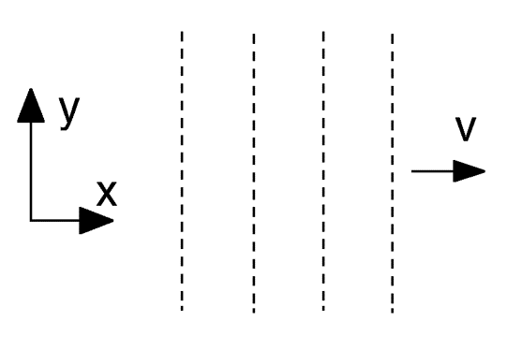
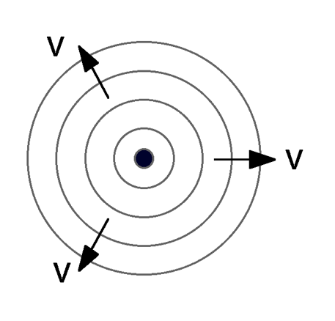
Basic Wave Front Concepts
Plane Wave Front
Spherical Wave Front
Surface of constant
disturbance, A, (or constant
phase) is a plane – i.e. peaks
and troughs form parallel planes.
Surface of constant phase is a sphere, with the wave source at the centre.

Slide 6

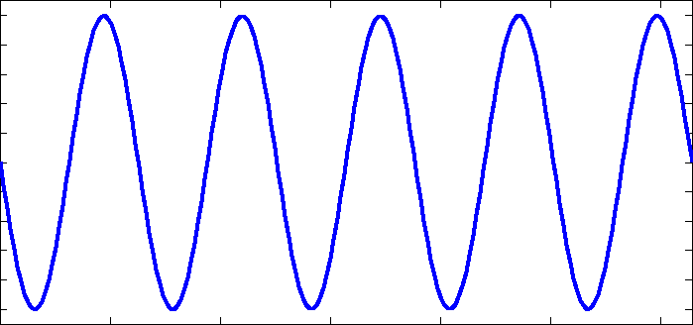
Waves
Wave Pulse Continuous Wave

Slide 7
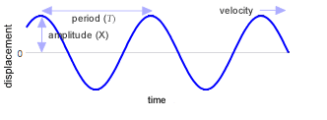
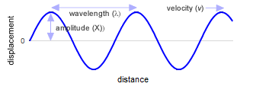
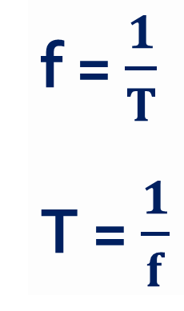
Amplitude, Frequency, Period, Speed and Wavelength
f = $\frac{1}{T}$
T = $\frac{1}{f}$

Slide 8
Amplitude, Frequency, Period, Speed and Wavelength
The wavelength (λ) is the distance between adjacent identical parts of the wave. For a sinusoidal wave this is the distance between troughs (crests).
Wavelength has a unit of distance (m).
The period (T) is the time taken for one complete up and down motion.
Period has a unit of time (s).

Slide 9

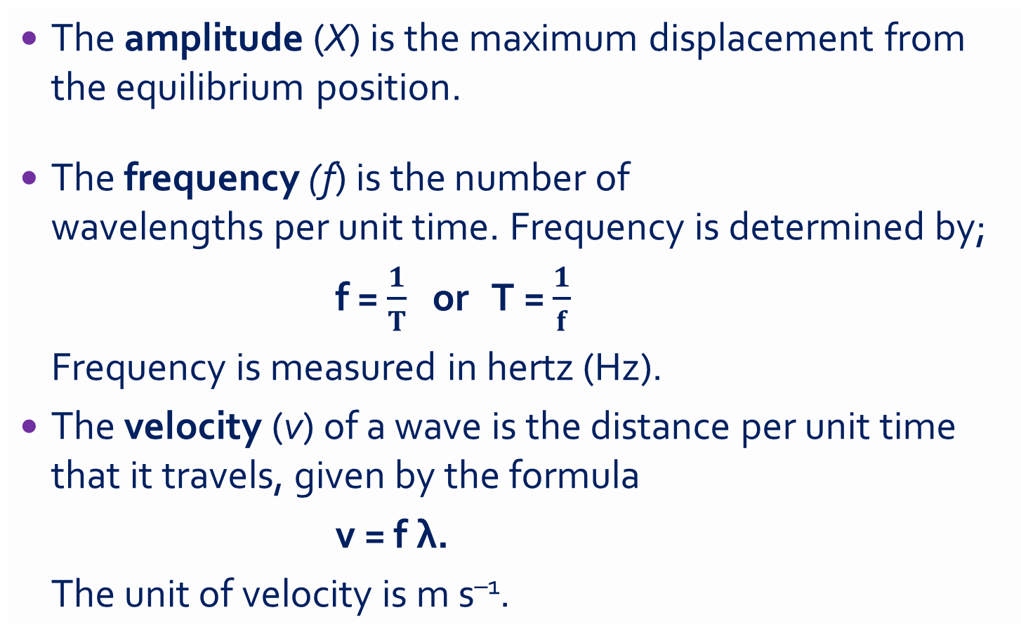
Amplitude, Frequency, Period, Speed and Wavelength
The amplitude (X) is the maximum displacement from the equilibrium position.
The frequency (f) is the number of
wavelengths per unit time. Frequency is determined by;
f = $\frac{1}{T}$ or T = $\frac{1}{f}$
Frequency is measured in hertz (Hz).
The velocity (v) of a wave is the distance per unit time that it travels, given by the formula
v = f λ.
The unit of velocity is m s^{–1}.

Slide 10
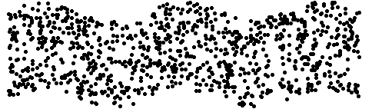
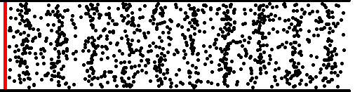
Transverse wave in a liquid
Longitudinal wave in a gas

Slide 11
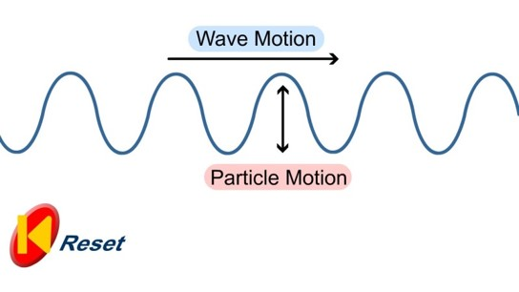
Transverse Mechanical Wave
Where particles vibrate in a direction perpendicular to that of the energy flow.
Examples: Electromagnetic (Light, Radio) waves and Water waves.

Slide 12
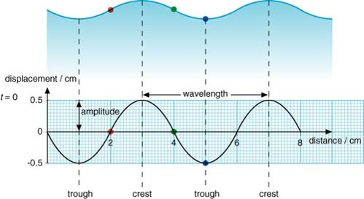
Transverse Mechanical Wave
The trough and crests are locations of maximum displacement.

Slide 13
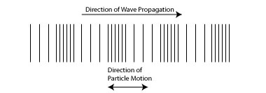
Longitudinal Mechanical Wave
Where particles vibrate in a direction parallel to that of the energy flow.
Examples: Sound waves

Slide 14
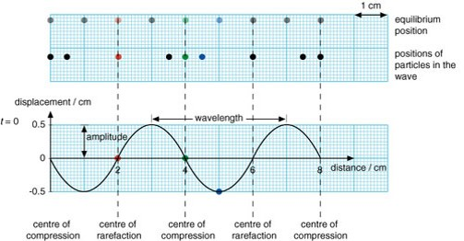
Longitudinal Mechanical Wave
The rarefaction and compression points are locations of maximum pressure.

Slide 15
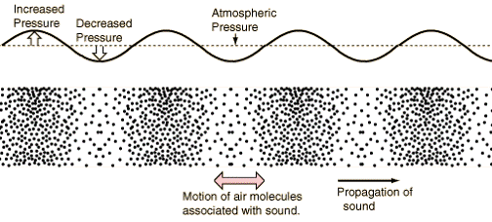
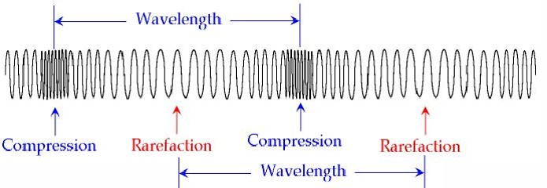
Longitudinal Mechanical Wave

Slide 16
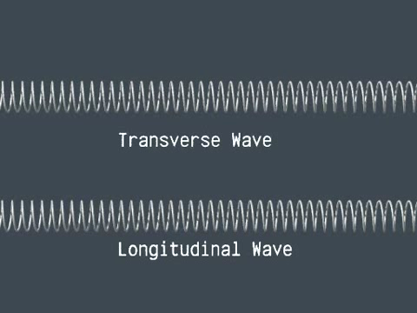
Transverse & Longitudinal Waves

Slide 17
Homework, Context & Keywords
Homework
Complete all questions from Set 10.1 - due first lesson next week.
Read Chapter 10.2, page 319-321 and answer
Q1 Set 10.2
by next lesson.

Slide 18
Sound Waves
Chapter 10.2 Pages 319-321

Slide 19
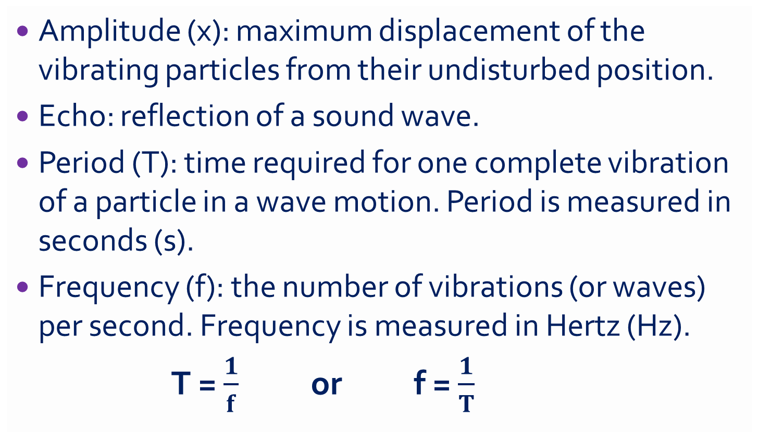
Terminology
Amplitude (x): maximum displacement of the vibrating particles from their undisturbed position.
Echo: reflection of a sound wave.
Period (T): time required for one complete vibration of a particle in a wave motion. Period is measured in seconds (s).
Frequency (f): the number of vibrations (or waves) per second. Frequency is measured in Hertz (Hz).
T = $\frac{1}{f}$ or f = $\frac{1}{T}$

Slide 20
Terminology
Reverberation: multiple echoes of the same sound.
Wavelength (λ): the distance between any two consecutive points in a wave which are in phase. Wavelength is measured in metres.
Phase: the stage of vibration that a particle has reached in its cycle of motion.
Pitch is what we hear change as frequency changes.
Velocity (v): the speed with which a progressive wave travels through a medium. Velocity measures in m s⁻¹.
v = f λ

Slide 21
Speed of Sound (in substances)
Substance | Conditions | Speed
Air | Dry, 25 ºC, 101.3 kPa | 346 ms⁻¹
Helium | 25 ºC, 101.3 kPa | 985 ms⁻¹
Oxygen | 25 ºC, 101.3 kPa | 330 ms⁻¹
Glycerol | 25 ºC | 1900 ms⁻¹
Water (distilled) | 25 ºC | 1500 ms⁻¹
Water (sea) | 25 ºC | 1530 ms⁻¹
Cork (thin rod) | 25 ºC | 500 ms⁻¹
Glass (thin rod) | 25 ºC | 4340 ms⁻¹
Aluminium (thin rod) | 25 ºC | 5000 ms⁻¹
Lead (thin rod) | 25 ºC | 1200 ms⁻¹
Soft Iron (thin rod) | 25 ºC | 5200 ms⁻¹

Slide 22
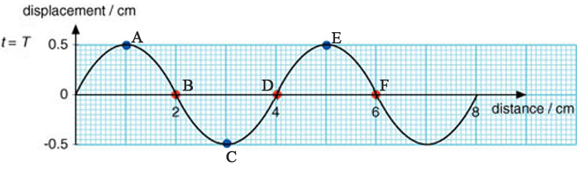
Example 10.2 a
Answer the following, giving appropriate units.
The wavelength (λ) is _______
The amplitude (x) is _______
List points in phase: _________________
List points in “completely” out of phase: ____________

Slide 23
Example 10.2 a
Answer the following, giving appropriate units/
List points with maximum upwards velocity: ________
If the frequency (f) is 2 Hz, what is the period (T)?
What is the speed of the wave at 2 Hz?

Slide 24
Example 10.2 b
One of the loud speakers from a sound system is capable of producing good quality sound in the frequency range of 450 – 4000 Hz. Assuming the speed of sound is 340 m s⁻¹, find;
The maximum distance between the compression waves emitted by this speaker.

Slide 25
Example 10.2 b
One of the loud speakers from a sound system is capable of producing good quality sound in the frequency range of 450 – 4000 Hz. Assuming the speed of sound is 340 m s⁻¹, find;
The smallest time interval between successive compression waves.

Slide 26
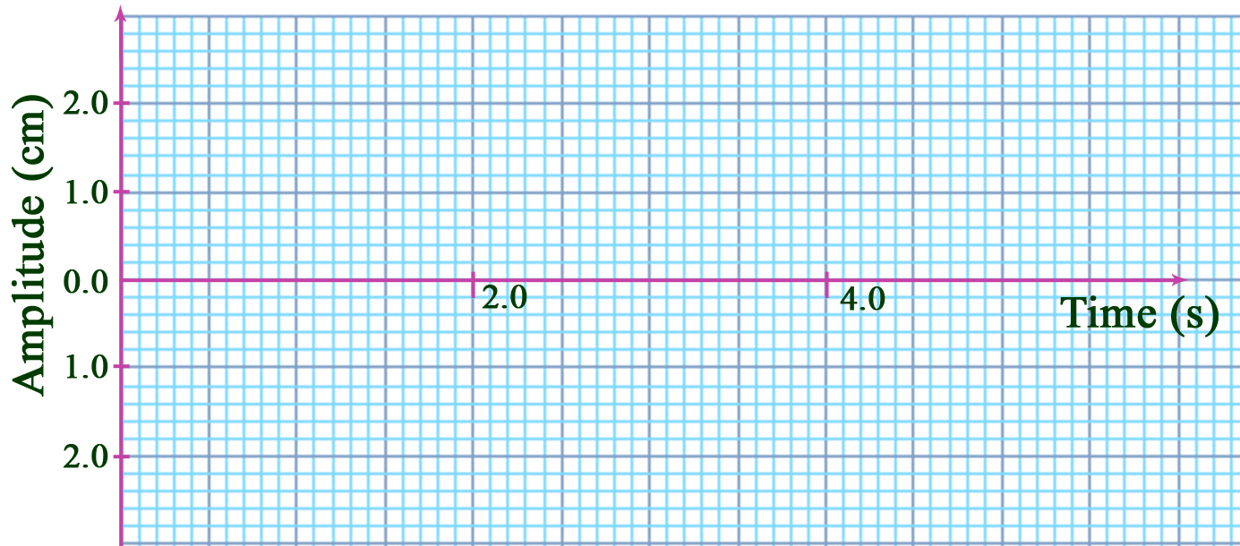
Example 10.2 c
Draw a wave form of period 2.0 seconds and amplitude 1.0 cm. On the same graph draw another wave form of period 2.0 seconds but with an amplitude 2.5 cm and out of phase by 180º.
Advanced: Then on the same axis, draw the resultant wave.

Slide 27
Example 10.2 d
Calculate the frequencies for waves of periods.
12.5 seconds
0.05 seconds

Slide 28
Example 10.2 e
A small stone is thrown onto the surface of a still pond of water. After 5 seconds thirty waves are seen to cover a distance of 2 metres from the centre. Calculate the wavelength, speed and frequency of the waves in the water.
Solution
Frequency:
Wavelength:
Velocity:

Slide 29
Homework, Context & Keywords
Homework
Complete all questions from Set 10.2 - due first lesson next week.
Read Chapter 10.3, page 323-330 and answer
Q1&2 Set 10.3
by next lesson.

Slide 30
Wave Behaviours
Chapter 10.3 Pages 323-330
2 lessons

Slide 31
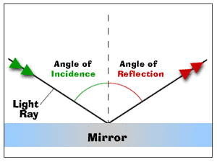
Reflection
When the wave does not pass through the solid barrier it encounters. The light ray that hits the mirror is called the incident ray. The light ray that bounces off the mirror is called the reflected ray.
Law of reflection
Angle of incidence (θ_{i}) = Angle of reflection (θ_{r})
Incidence ray and reflected ray are on the opposite sides of the normal.

Slide 32
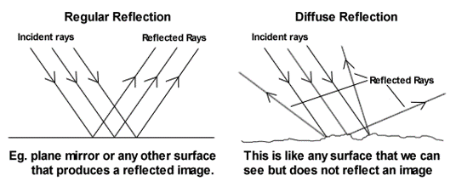
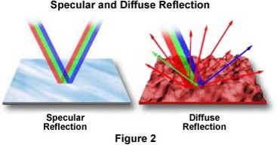
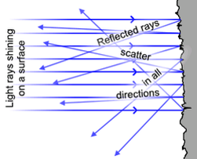
Reflection

Slide 33
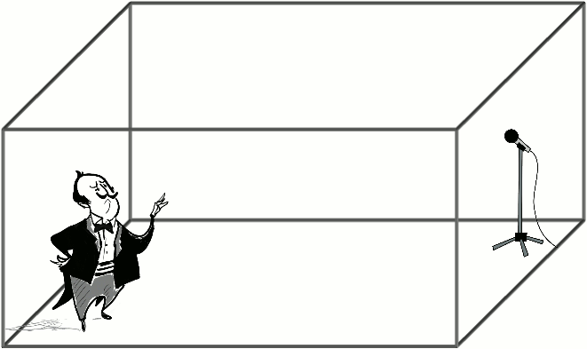
Reverberation

Slide 34
Example 10.3a
Jacob and Paula are standing 25 m and 15 m respectively from a large building when Jacob calls out loudly. Assume the speed of sound to be 340 ms⁻¹ and that good reflection of sound occurs from the building.
Draw a diagram illustrating the situation

Slide 35
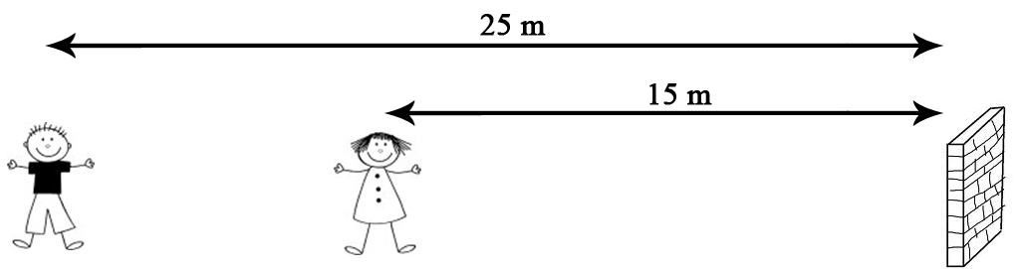
Example 10.3a
Find the time delay between the two sounds Paula will hear.

Slide 36
Example 10.3a
Will Paula hear an echo?
Will Jacob detect the echo?

Slide 37
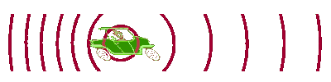
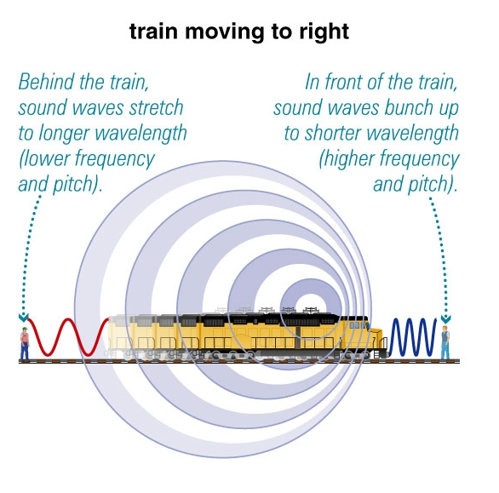
Doppler Effect

Slide 38
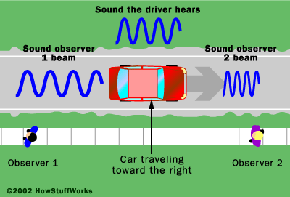




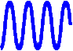
Doppler Effect
rdrgtfrdfg

Slide 39
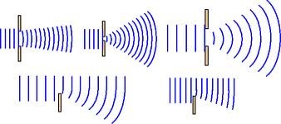
Diffraction
Waves are able to bend around obstacles or narrow openings.
Diffraction depends on
Size of wavelength (larger wavelengths diffract better than smaller wavelengths).
Size of opening (diffraction is greatest when the wavelength is greater than the opening).

Slide 40
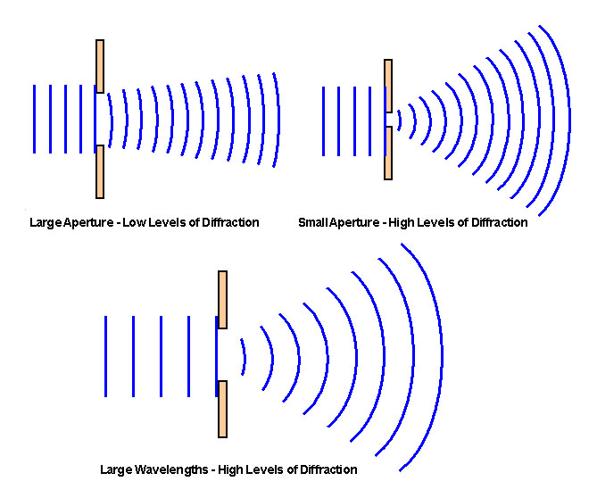
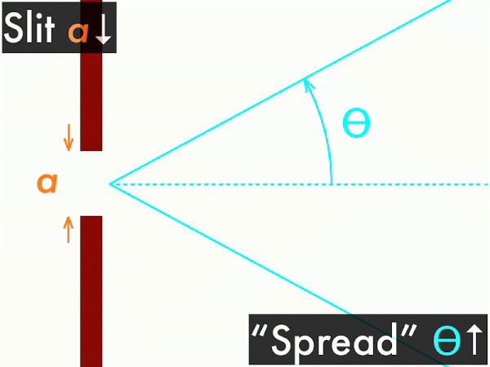
Diffraction

Slide 41
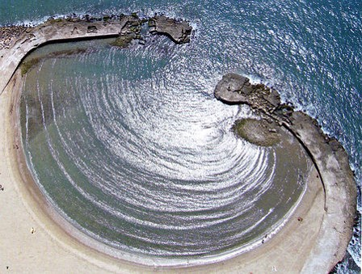
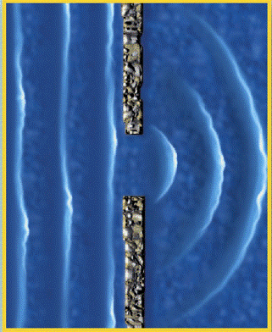
Diffraction
Wavelength can also be influenced by the type of medium propagating waves (e.g. water) and it’s viscosity and hydrogen bonding properties that gives it its “sticky” effects.

Slide 42
Example 10.3b
Sketch the appearance of the waves after they have encountered the obstacle or gap, as shown when D is equal to λ.
D
D
D
D

Slide 43
Refraction
Refraction can occur when the speed of a wave changes, as it moves from one environment (medium) to another. After refraction, the wave has the same frequency but a different speed, wavelength and direction.
When a wave enters a new environment, its change in speed will change its wavelength.
If the wave enters the new environment at any angle other than normal to the boundary, then the change in the wave's speed will also change its direction.

Slide 44
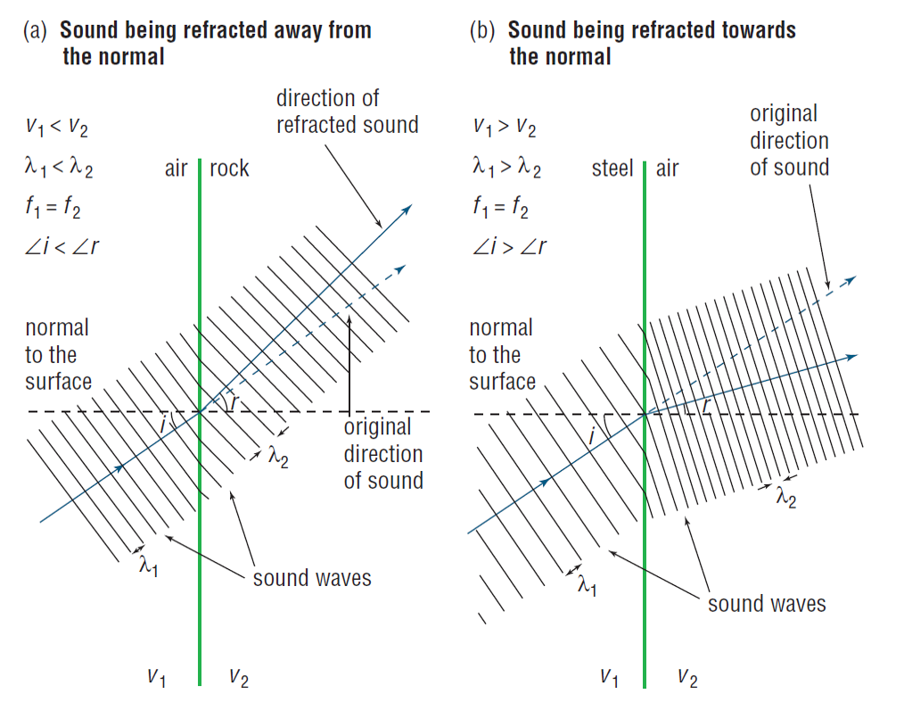
Refraction
Bends towards the normal where the speed slows as it enters a new medium.
Bends away from the normal where the speed increases as it enters the new medium.

Slide 45
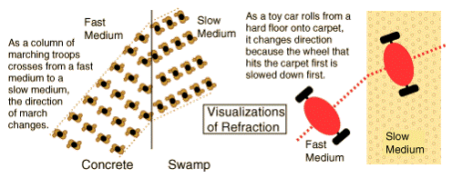
Refraction

Slide 46
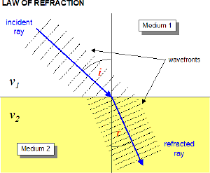
Refraction
v₁ > v₂
λ₁ > λ₂
Li > Lr
Hence “Medium 1” is a more solid medium than “Medium 2”.

Slide 47
Homework, Context & Keywords
Homework
Complete all questions from Set 10.3 - due first lesson next week.
Read Chapter 10.4, page 330-334 and answer
Q1, 2 & 3 Set 10.4
by next lesson.

Slide 48
Superposition
Chapter 10.4 Pages 330-334

Slide 49
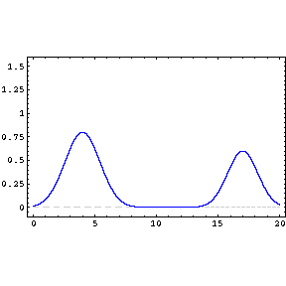
Superposition
Resulting displacement of two or more longitudinal or transverse waves.

Slide 50
Superposition
If two or more travelling waves are moving through some medium, the resultant wave displacement at any point is the algebraic sum of the individual wave displacements.

Slide 51
+
+
Beat:
When two different waves of different frequencies are added together to create a repetitive and constant rise and fall in intensity of sound.

Slide 52
Constructive Interference
These two waves arrive are IN PHASE

Slide 53
Destructive Interference
These two waves arrive in OUT OF PHASE (aka Anti-Phase)

Slide 54
Constructive Superposition

Slide 55
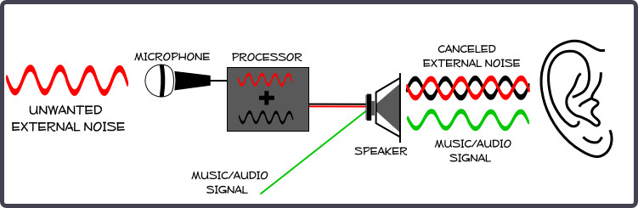
Superposition
Noise Reduction: Computers and microphones are used to reduce workplace noise. The microphone picks up the sound and the computer repeats the sound out of phase. Hence by destructive interference the noise is reduced.

Slide 56
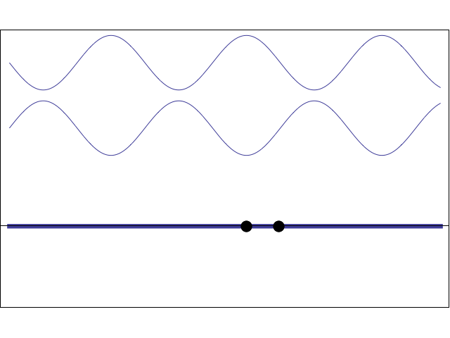
Standing Wave
Two counter-propagating travelling waves of same frequency and amplitude superpose to form a standing wave, characterised by
nodes (positions of zero disturbance) and
antinodes (positions of maximum disturbance)

Slide 57
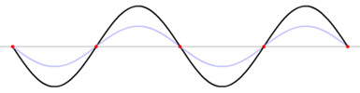
Standing Wave
ANTINODES
NODES
Node to Node = ½ λ
BETWEEN ANY PAIR OF ADJACENT NODES, ALL PARTICLES ARE MOVING IN PHASE

Slide 58
Forced vibrations
Forced vibrations are the result of a vibration caused by the continuous application of a repetitive force.
Free vibrations
Natural (or free) vibrations are the result of the “make up” of the object. Every object has a natural frequency. The natural frequency of a body depends on its elasticity and its shape.

Slide 59
Resonance
Occurs when the forced frequency equals the natural frequency of the object.
It is the maximum amplification which results in an obvious increase in sound or the destruction of an object (e.g. breaking glass with sound).
Unless the forcing frequency is equal to the natural frequency, the amplitude of oscillation will be small.
Effectively this repetitive force added to the natural frequency, becomes the building new natural frequency.

Slide 60
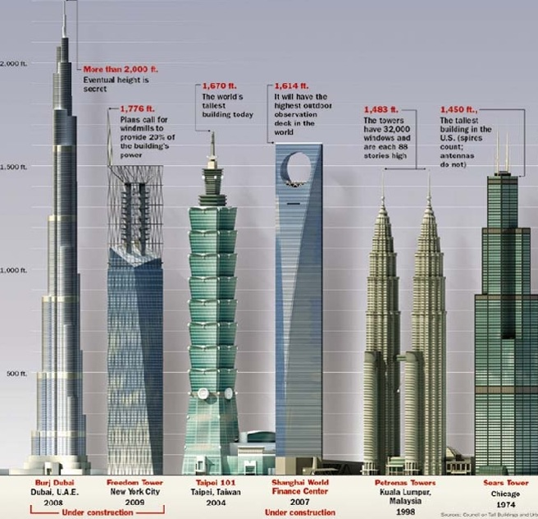
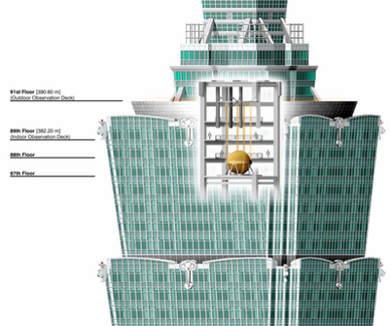
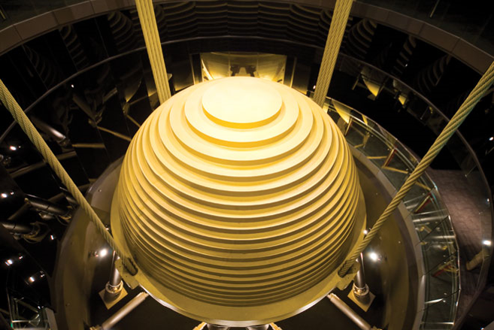
The 508m Taipei 101 Tower would sway back and forth up to 60cm each way within five seconds (Wired magazine). The Taipei 101 engineers included a 662 tonne counter giant pendulum to act as a counter weight. It is pushed in the opposite direction to the buildings sway to dampen the oscillation.

Slide 61
Homework, Context & Keywords
Homework
Complete all questions from Set 10.4 - due first lesson next week.
Read Chapter 10.5, page 334-336 and answer
Q1 Set 10.5
by next lesson.

Slide 62
Modes of Vibration
Chapter 10.5 Pages 334-336

Slide 63
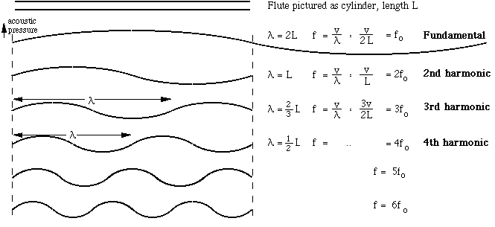
Standing Harmonics
As the wave tightens the pitch increases

Slide 64
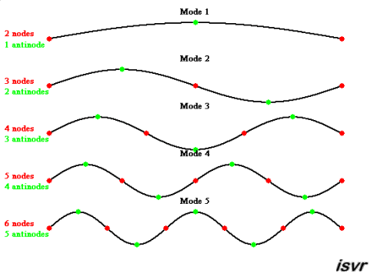
Standing Harmonics

Slide 65
Homework, Context & Keywords
Homework
Complete all questions from Set 10.5 - due first lesson next week.
Read Chapter 10.6, page 334-342 and answer
Q1 Set 10.6
by next lesson.

Slide 66
Vibration Influences
Chapter 10.6 Pages 334-342

Slide 67
Vibrations in air columns
Air columns in pipes can be set vibrating by blowing across the open end (includes tuning forks and loud speaker).
The standing waves in an air column are the result of two similar waves travelling in opposite directions.
Open ended pipes are open at both ends and closed pipes are closed at one end.

Slide 68
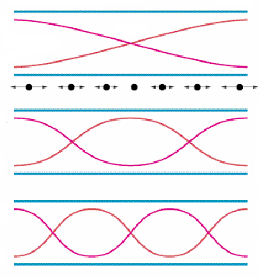
Stationary Waves in Open Pipes
FUNDAMENTAL l = λ/2
1st harmonic
actual air vibration
1st overtone l = λ
2nd harmonic
2nd overtone l = 3λ/2
3rd harmonic
λ = 2L
n
f = nv
2L
where λ is the wavelength of the nth harmonic (m), l is the effective length of the air column (m) and n is the number of the harmonic = 1, 2, 3, ... v is the velocity of the component waves (ms^{–1}).

Slide 69
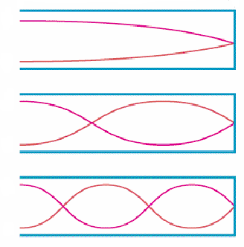
Stationary Waves in Closed Pipes
FUNDAMENTAL l = λ/4
1st harmonic
1st overtone l = 3λ/4
3rd harmonic
2nd overtone l = 5λ/4
5th harmonic
λ = 4L .
(2n – 1)
f = (2n – 1)v
4L
where λ is the wavelength of the nth harmonic (m), l is the effective length of the air column (m) and n is the number of the harmonic = 1, 3, 5, ... v is the velocity of the component waves (ms^{–1}).

Slide 70
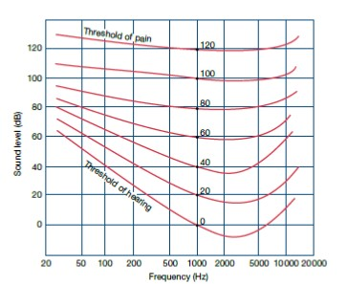
Example 10.6a
A hearing test speaker emits
only one frequency at a time.
The output level is gradually
altered and a listener notes at
what sound level he can hear
the sound. The test is repeated for a range of frequencies and the results are plotted.
What sound level at 50 Hz gives the same perceived loudness as a level of 20 dB at 500 Hz?
If the sound level produced by the loudspeaker was held at a constant 40 dB while the frequency was varied, what range of frequencies would be heard?

Slide 71
Example 10.6b
An organ pipe produces sound at 250 Hz, 500 Hz amd 1000 Hz. Assuming the speed of sound is 330 m s⁻¹, determine;
If it is an open or closed pipe
The length of the pipe

Slide 72
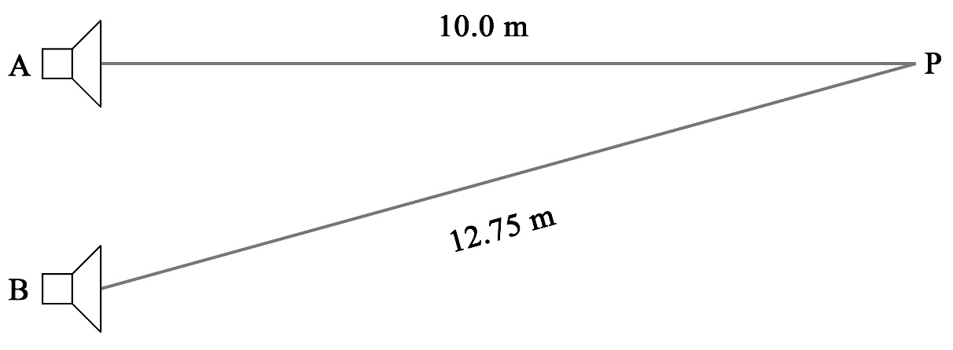
Example 10.6c
The two speakers below are producing 680 Hz note. Assume the speed of sound in the air is 340 ms⁻¹. Point P is 10.0 m from speaker A and 12.75 m from speaker B.
Determine if there is a node or anti-node at point P and what would we hear at this point. You must justify your answer to receive any marks. The wave position next to the speaker is an antinode.

Slide 73

Example 10.6c

Slide 74

Example 10.6c

Slide 75


Example 10.6b

Slide 76
Homework, Context & Keywords
Homework
Complete all questions from Set 10.6 - due first lesson next week.
Read Chapter 10.7, page 343-346 and answer
Q1&2 Set 10.7
by next lesson.

